Slide 1
Auctions,
Negotiations, and Reciprocity
IFORS Barcelona
Gregory E. Kersten* & Tomasz Wachowicz#
* Concordia University, Canada
# Katowice University of Economics, Poland

Slide 2
Mechanisms and context
Models, software, experiment
Efficiency: solution and mechanism
Improvements
Interpretations

Slide 3
Auctions & negotiations
Number of participants
  1:1, 1:n; n vs. 1:n; n:m
Behavior of participants
  All active vs. Active/passive
Information format
  Open vs. Structured
Information verifiability
  Non-verifiable vs. Verifiable

Slide 4
Procurement
Procurement: 70% of business expenses
Bothe reverse auctions and negotiations are used
Examples:
  Purchase of insurance provider; Road & facilities construction; Logistics, maintenance services
Often multi-attribute
  In addition to price also quality, delivery, warranty, additional features, discounts, etc.
  EU directives; US policies

Slide 5
Literature
Theory
  Bid-takers should use auctions (Bulow & Klemperer 1996)
Field studies
  Different mechanisms for different situations (Bajari et al. 2004; Chong et al. 2014)
  Auctions lower procurement price (Lalive et al. 2012)
Experiments
  Multi-bilateral negotiations and auctions result in the same price value (Thomas & Wilson 2002)
  Verifiable multi-bilateral negotiations result in lower prices than the Vickerey auctions. Both mechanisms result in efficient prices (Thomas & Wilson 2005)

Slide 6
Literature
Field studies
  Multi-attribute auctions were implemented but terminated after a few years (Bichler et al., 2006; Gupta et al. 2012)
  Two-attribute procurement auctions would save 20% of the contracts’ value without increasing contractor cost (Lewis and Bajari 2011)
Experiments
  Multi-attribute auctions are better for the buyers than multi-bilateral negotiations (Bellantuono et al. 2012; Kersten et al. 2013)

Slide 7
This study
Three mechanisms
  Multi-attribute reverse auctions
  Multi-bilateral non-verifiable negotiations
  Multi-bilateral verifiable negotiations
What are the differences between these mechanisms?
  The buyer can convert verifiable negotiations to auction

Slide 8
Software and tools
Three web-based systems developed in the Invite platform
Support
  Automatic notification
  Utility construction
  Offer and bid generation
  Visualization

Slide 9
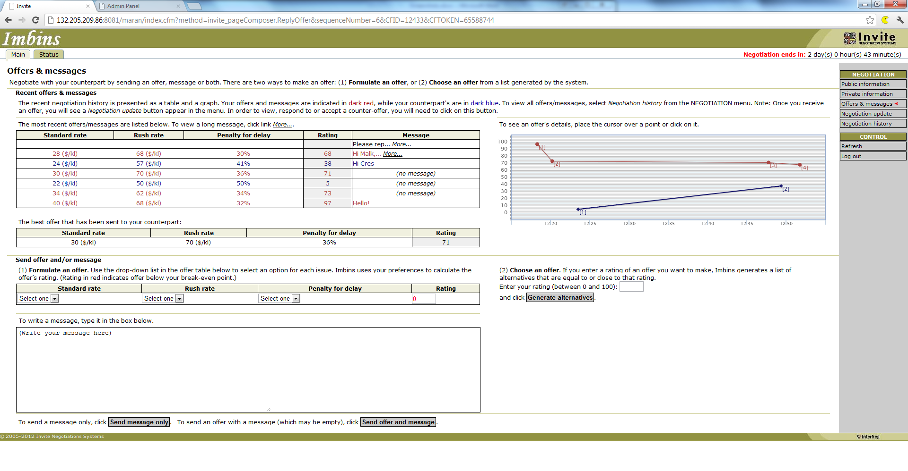
Verifiable negotiations
Best offer on the table

Slide 10
Experiment
Procurement case:
  Three attributes; 3375 alternatives
Process
  Video + quizzes;
  Anonymous; 10 days
Participants
  Sellers -- 583 students; Buyers -- 83 students from 3 countries

Slide 11
Results: Outcomes
 | Auctions | Negotiations
 |  | Verifiable | Non-verifiable
Agreement % | 100 | 100 | 100
- Buyer’s offer accepted (%) | — | 30 (71) | 24 (61)
- Seller’s offer accepted (%) | 38 (100) | 12 (29) | 15 (39)
Profits
- Buyers’ profit (avg.) | 45.9* | 20.8** | 27.8**
- Sellers’ profit (avg.) | −7.2* | 18.8*^ | 11.9*^
Solution efficiency
- Distance (L₁) to efficient frontier | 0.74* | 8.38* | 7.32*
- No. of dominating alternatives | 3.5* | 81.5** | 38.1**
Mechanism allocative efficiency
- Social welfare (joint profit) | 38.7 | 39.6 | 39.7
- Ratio % | 40 | 40 | 40

Slide 12
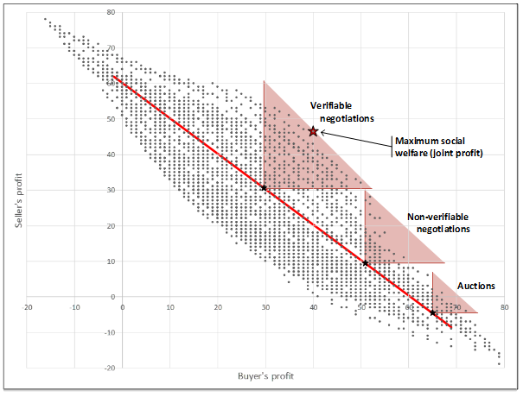
Three mechanisms

Slide 13
Observations
Auctions are best for the buyers and worst for the sellers
Auctions outcomes are closer to the efficient frontier
Auctions are inefficient mechanisms
Verifiable negotiations are best for the sellers and worst for the buyers

Slide 14
Auctions’ efficiency
Auctions are efficient mechanisms if and only if utilities are quasi-linear (u_{b}(x) = v_{b}(x₋₁) – x­₁; u_{i}(x) = x₁ – v_{i}(x₋₁)) (Kersten 2014)
⇒ efficient frontier is interval (-1)
Auctions outcomes cannot be improved in terms of efficiency, but:
    Negotiations can become efficient mechanisms, and
    Successful auctions can be followed by negotiations so that joint improvement are achieved

Slide 15
Negotiations’ efficiency
The old negotiation problem: how to search for integrative solutions

Slide 16
Winning bid improvement
Move from A to B: Seller’s utility increases 6 times more than Buyer’s utility decreases
Negotiations?
Auctions

Slide 17
Verifiable vs. non-verifiable
Why are verifiable negotiations better for the sellers and worse for the buyers than non-verifiable negotiations?
Social Exchange Theory
  Reciprocity (Fehr et al. 2003; Charness, 2002)
  Aversion to inequity (Bolton, 2000; Zafirovski, 2005)
Observation of offers made by others causes the sellers’ withdrawal

Slide 18
Verifiable negotiations
Observation of offers made by others causes the sellers’ withdrawal from the process earlier than in non-verifiable negotiations
Sellers lower satisfaction indicates their early withdraw
Satisfaction with balance | Verifiable | Non-verifiable
Sellers’ satisfaction | 1.08 * | 1.25 *
Buyers’ satisfaction | 0.97 * | 1.44 *

Slide 19
Behavioural OR
Behavioral aspects related to the use of OR methods in modeling, problem solving & decision & negotiation support (R. Hämäläinen 2014; L.A. Franco, E. Rouwette)

Slide 20
Thank you!

